Slide 1
Azure DevOps

Slide 2
Azure Boards
Azure Repos
Azure Pipelines
Azure Test Plans
Azure Artifacts

Slide 3
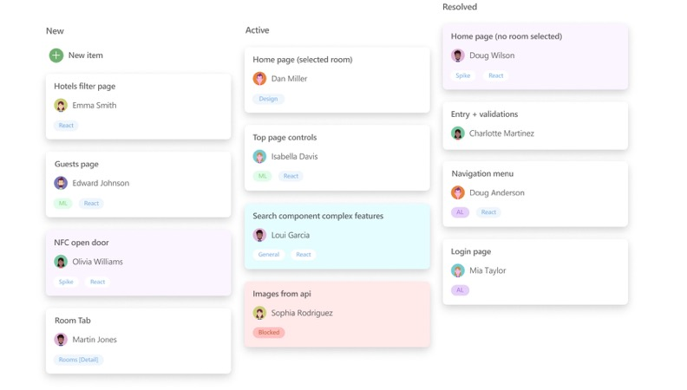
Azure Boards
Agile planning tools
Track work with configurable Kanban boards, interactive backlogs, and powerful planning tools. Unparalleled traceability and reporting make Boards the perfect home for all your ideas—big and small.

Slide 4



Azure Boards
Combine drag-and-drop sprint planning and flexible work item tracking with comprehensive traceability to have the perfect home for all your ideas–big and small.
Connected from idea to release
Track all your ideas at every development stage and keep your team aligned with all code changes linked directly to work items.
Azure Pipelines
Scrum ready
Use built-in scrum boards and planning tools to help your teams run sprints, stand-ups, and planning meetings.
Use proven productivity tools
Get your work done with simple and modern agile tools like Kanban boards, backlogs, dashboards, and scrum boards. Adapt the tools to fit your team’s needs and scale up easily.
Built for insights
Gain new insights into the health and status of your project with powerful analytics tools and dashboard widgets.

Slide 5
Azure Pipelines
CI/CD for any platform
Continuously build, test, and deploy to any platform and any cloud

Slide 6


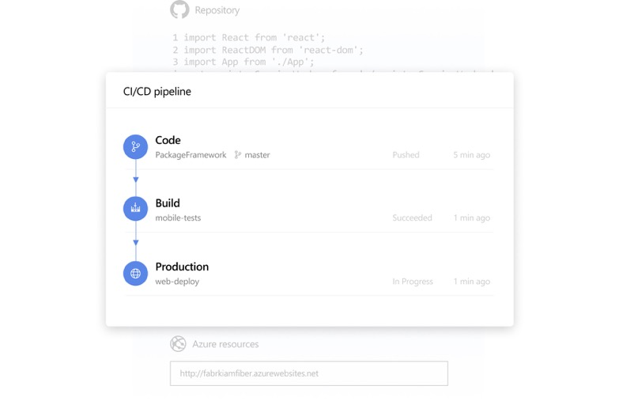



Azure Pipelines
Any language, any platform
Build, test, and deploy Node.js, Python, Java, PHP, Ruby, C/C++, .NET, Android, and iOS apps. Run in parallel on Linux, macOS, and Windows.
Get cloud-hosted pipelines for Linux, macOS, and Windows
Automate your builds and deployments with Pipelines so you spend less time with the nuts and bolts and more time being creative.
Containers and Kubernetes
Easily build and push images to container registries like Docker Hub and Azure Container Registry. Deploy containers to individual hosts or Kubernetes.
Azure Repos
Extensible
Explore and implement a wide range of community-built build, test, and deployment tasks, along with hundreds of extensions from Slack to SonarCloud.
Deploy to any cloud
Implement continuous delivery (CD) of your software to any cloud, including Azure, AWS, and GCP. Visualize deployment to any number of interdependent stages.
Advanced workflows and features
Take advantage of easy build chaining and multi-phased builds. Support for YAML, test integration, release gates, reporting—and more.

Slide 7
Azure Repos
Unlimited free private repos, cloud-hosted private Git repos, pull requests, and code search for your project
Get flexible, powerful Git hosting with effective code reviews and unlimited free repositories for all your ideas—from a one-person project to the world’s largest repository.

Slide 8
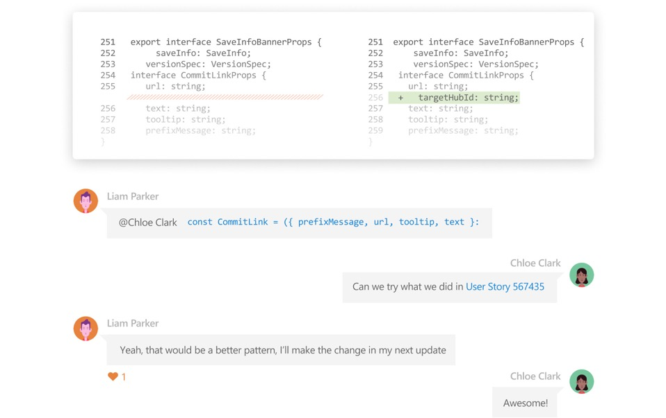



Azure Repos
Get unlimited private Git repository hosting and support for TFVC that scales from a hobby project to the world’s largest repository.
Azure Test Plans
Support for any Git client
Securely connect with and push code into your Git repos from any IDE, editor, or Git client.
Web hooks and API integration
Add validations and extensions from the marketplace or build your own using web hooks and REST APIs.
Semantic code search
Quickly find what you’re looking for with code-aware search that understands classes and variables.

Slide 9
Azure Test Plans
Manual and exploratory testing
Test and ship with confidence with a manual and exploratory testing toolkit

Slide 10
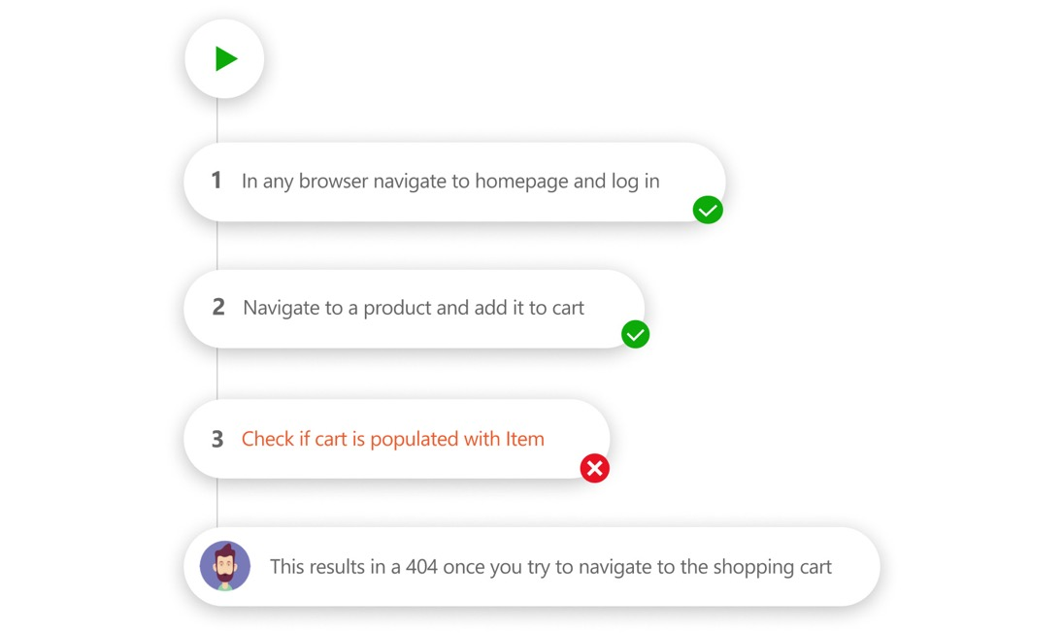
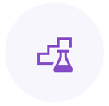


Azure Test Plans
Improve your code quality using planned and exploratory testing services for your apps.
Azure Artifacts
Get end-to-end traceability
Take advantage of end-to-end traceability and quality for your stories and features.
Test across web and desktop
Test your application by executing tests across desktop or web apps.
Capture rich data
Capture rich scenario data as you execute tests to make discovered defects actionable.

Slide 11
Azure Artifacts
Universal package repository
Create, host, and share Maven, npm, and NuGet package feeds from public and private sources

Slide 12
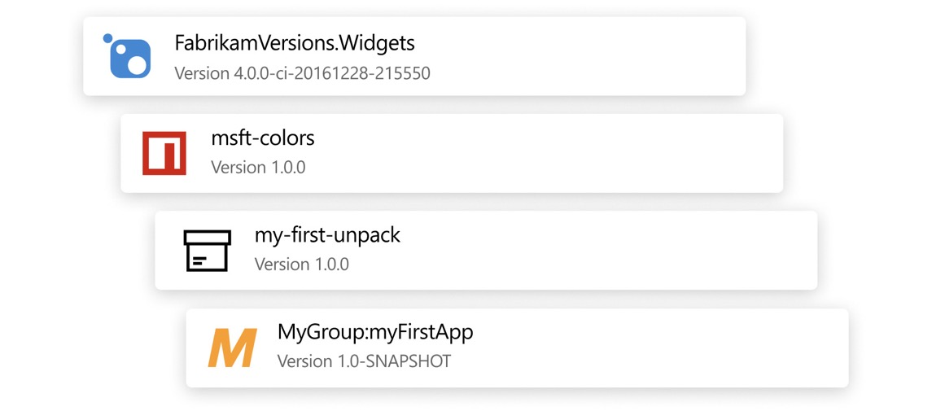



Azure Artifacts
Add fully integrated package management to your continuous integration/continuous delivery (CI/CD) pipelines with a single click. Create and share Maven, npm, and NuGet packages from public and private sources with teams of any size.
Share code efficiently
Easily share code across small teams and large enterprises.
Manage all package types
Get universal artifact management for Maven, npm, and NuGet.
Add packages to any pipeline
Share packages, and use built-in CI/CD, versioning, and testing.

